Slide 1
Reproducibility Challenge
Big Data for Health, CSE6250
Reproduction of “Predicting Heart Failure from Clinical Notes using Deep Learning”
Siddiqui, Muhammad N. Pratt, Luke O. December 2023

Slide 2
Natural language is everywhere!
Its all over the place
Doctor’s notes
Medical research
Textbooks
Prescriptions
Administrative notes
However, it has been traditionally challenging to incorporate this huge source of powerful data into healthcare models

Slide 3
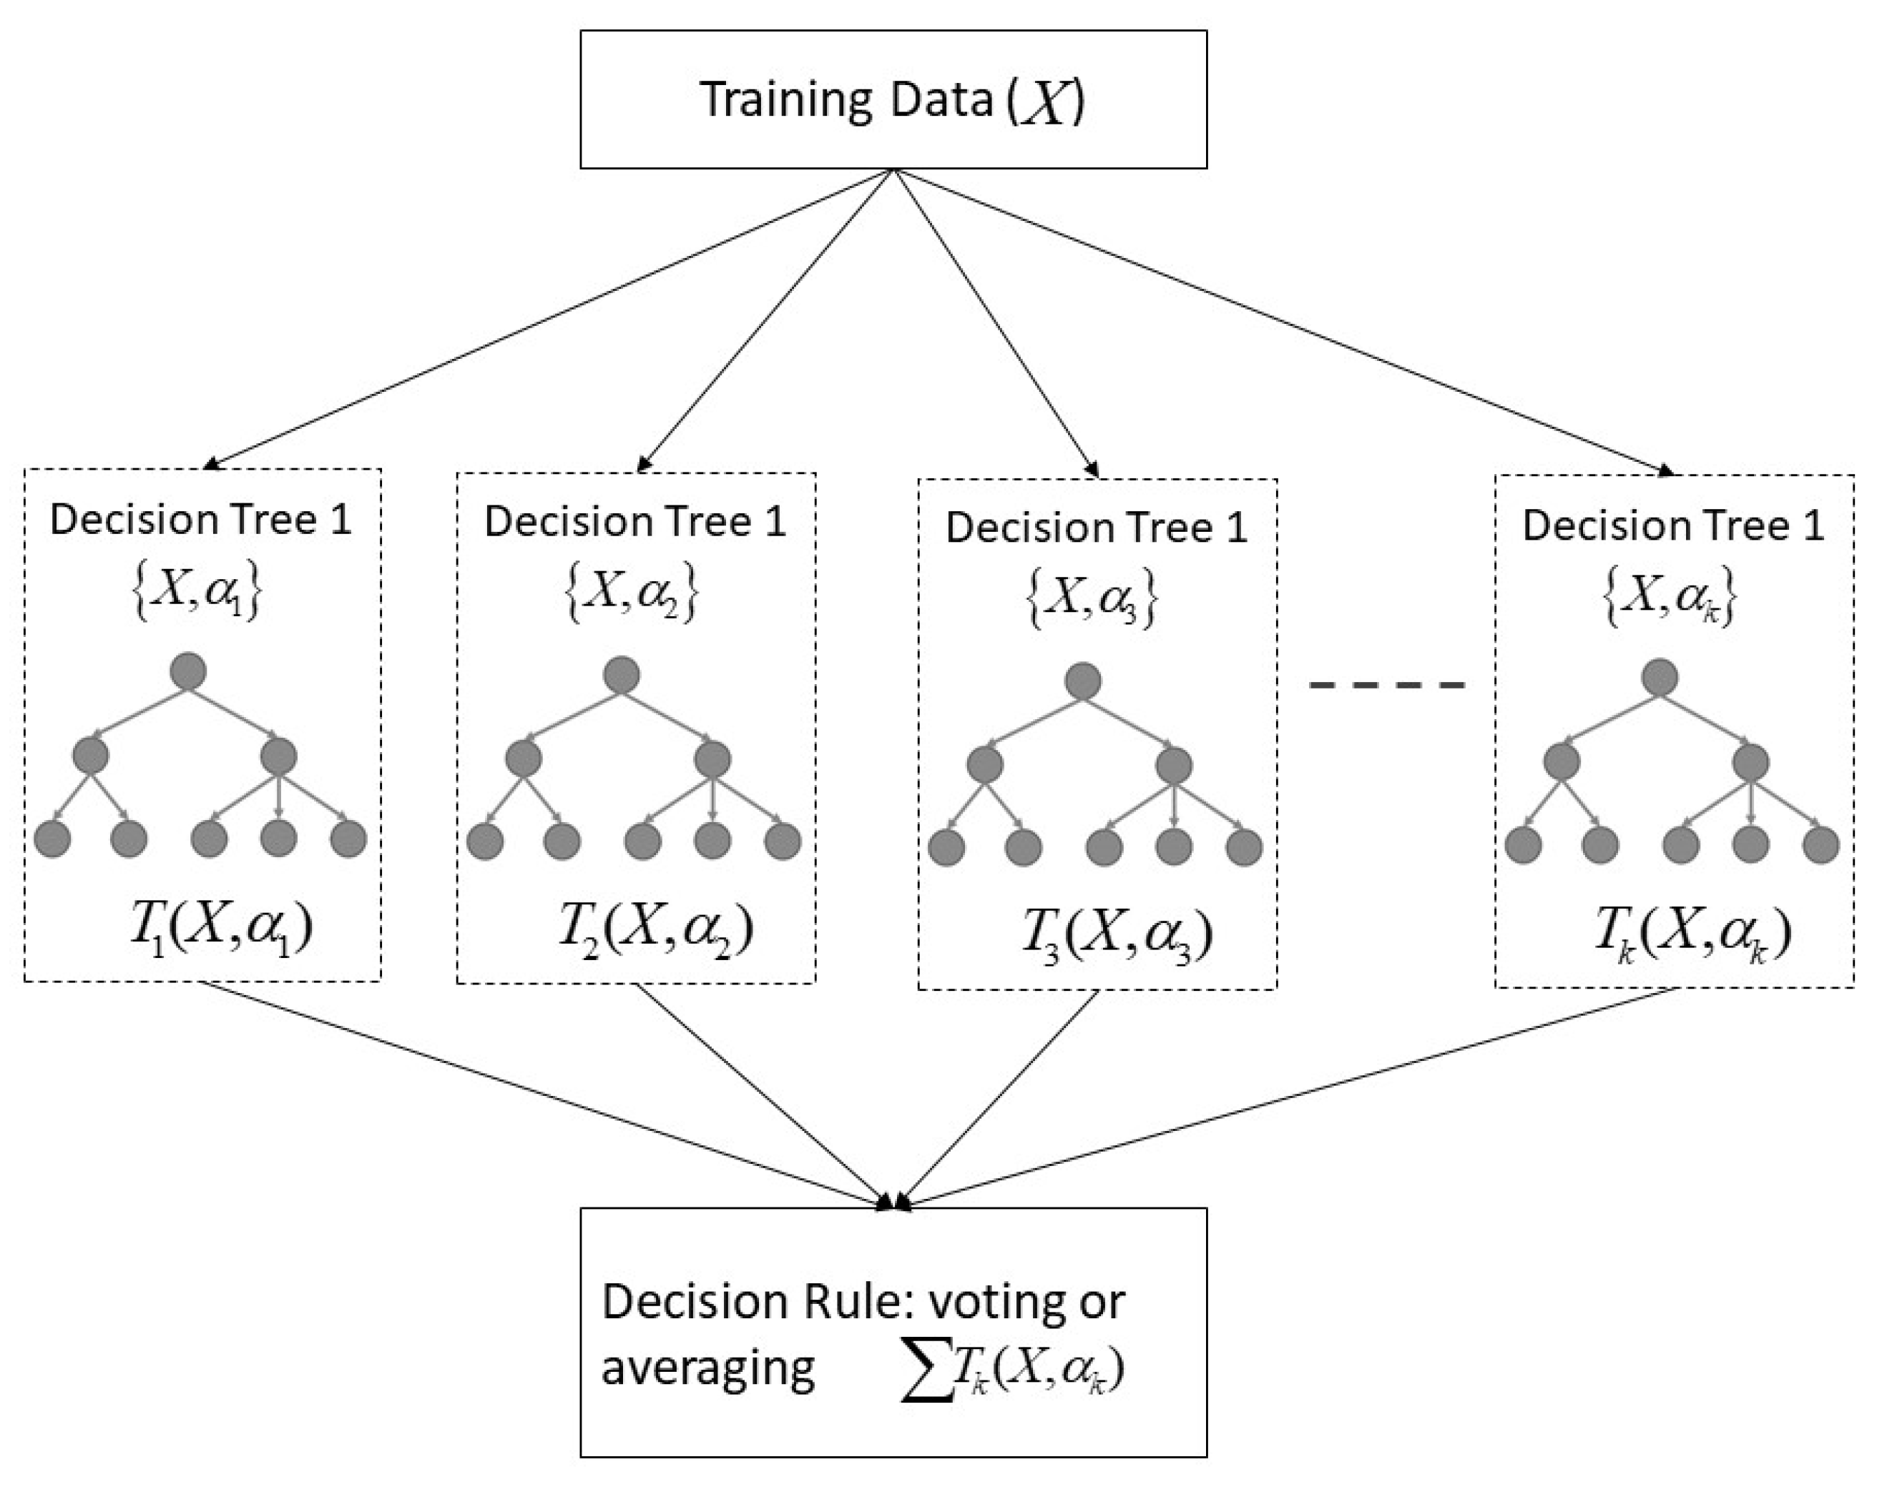
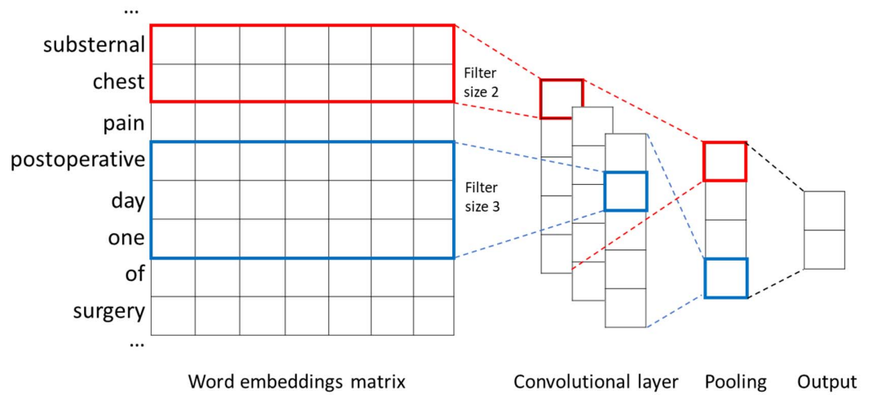
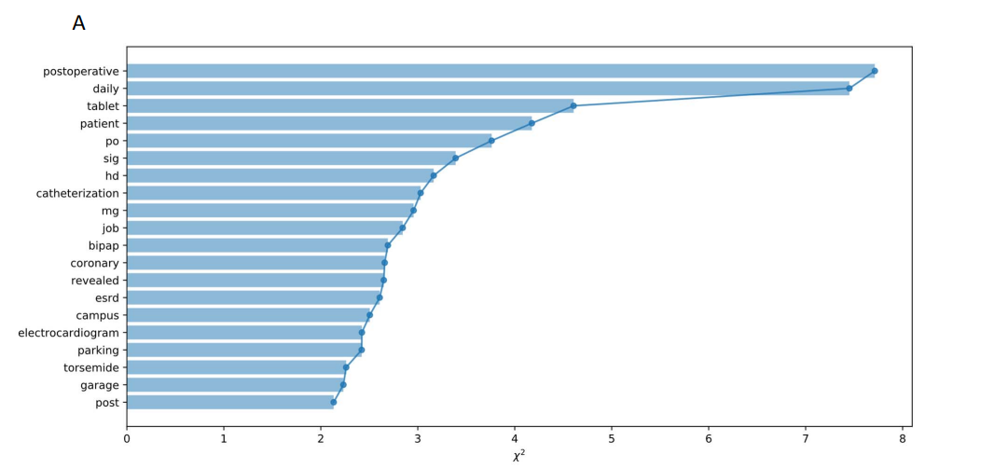
The Reproduction Scope
Random forest trained on TF-IDF scores (baseline)
Convolutional neural network trained on word embeddings (hypothesis)
Chi-square feature analysis

Slide 4
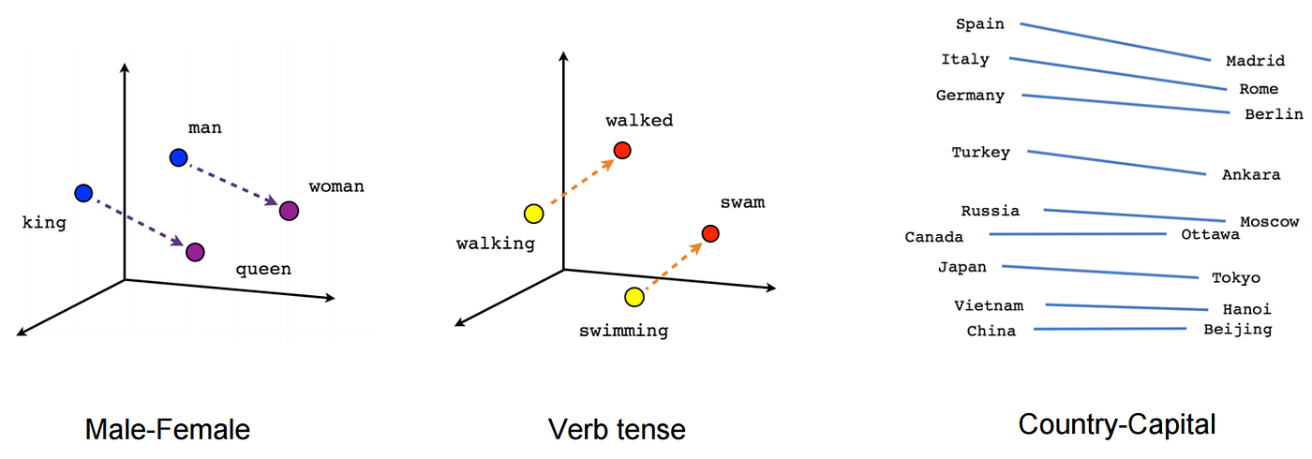
Word Embeddings
Word embeddings are a dimensionality reduction technique to represent words in vectorized numbers of their contextual associations found in the training literature. Colloquially each dimension can be thought of as a concept the word may or may not be associated with. The paper uses a dimensionality of 200 trained on PubMed papers

Slide 5
Convolutional Neural Network
Convolutional neural network with varying filter sizes applied to PubMed word2Vect vectorized representations of the words, with 200 dimensions per word

Slide 6
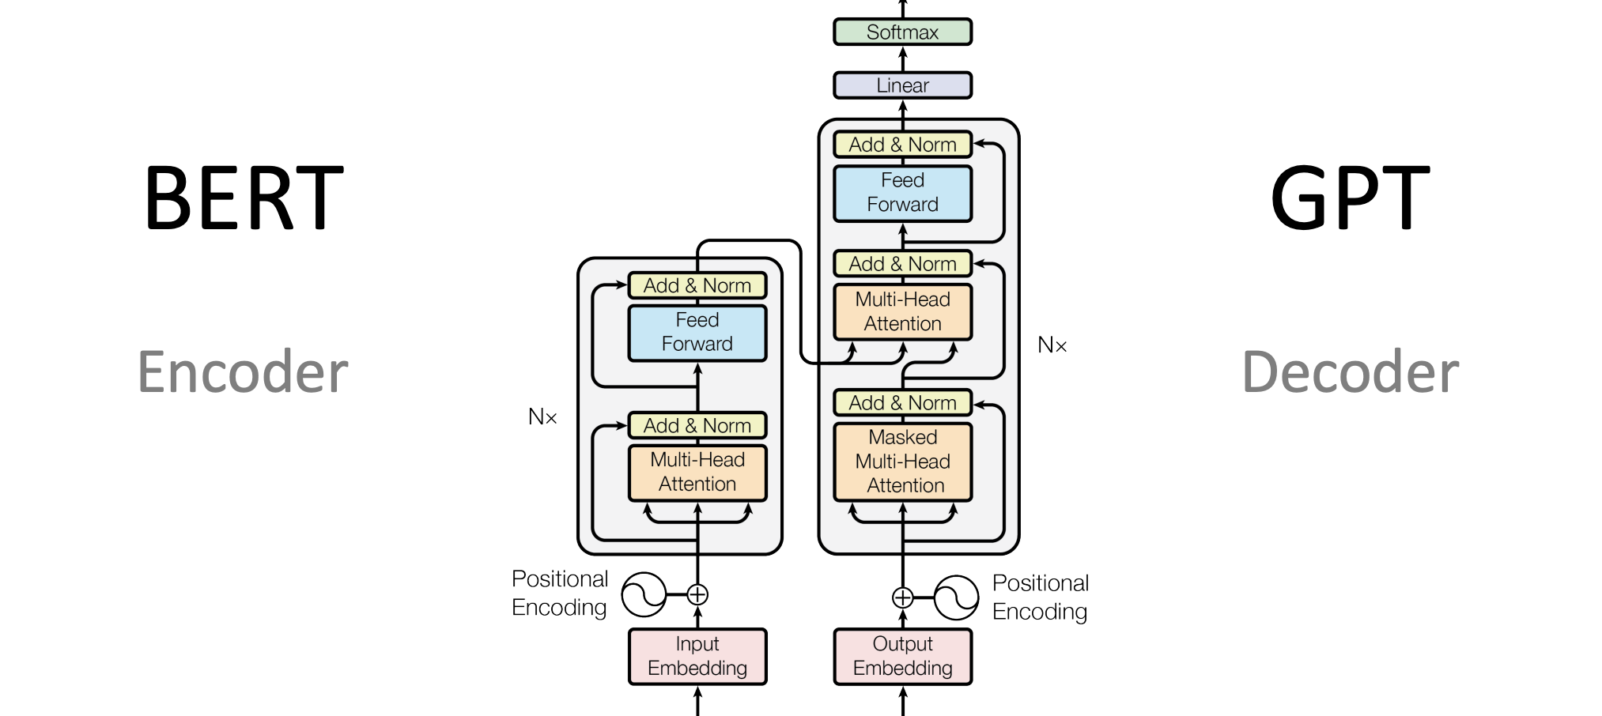
More Background
Since this paper was written, the state of the art has pivoted to transformers
Future would include adding a transformer model to this reproduction

Slide 7
Baseline
Random forest is another common model for natural language not requiring feature engineering

Slide 8
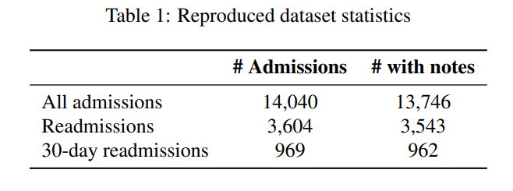
Data Collection
Data Collected from MIMIC-III database in Google Big Query
CITI certification required for access
We were able to successfully reproduce their dataset statistics

Slide 9
Data Processing
Results of Google Big Query imported as CSV and converted locally to a Pandas data frame
90% of data used for training, 10% withheld for validation
Tokenization of data for CNN
TF-IDF transformation for random forest on unprocessed data
Transformation is fit on training data only to avoid learning from test data
Unknown words are omitted during testing

Slide 10
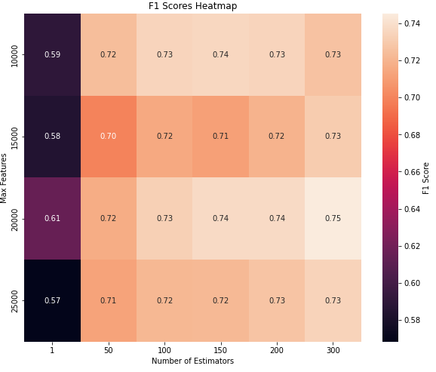
Random Forest Tuning
F1 scores for random forest trained on TF-IDF scores of each discharge report
Trained by grid search for number of trees and number of features per tree
General readmission shown

Slide 11
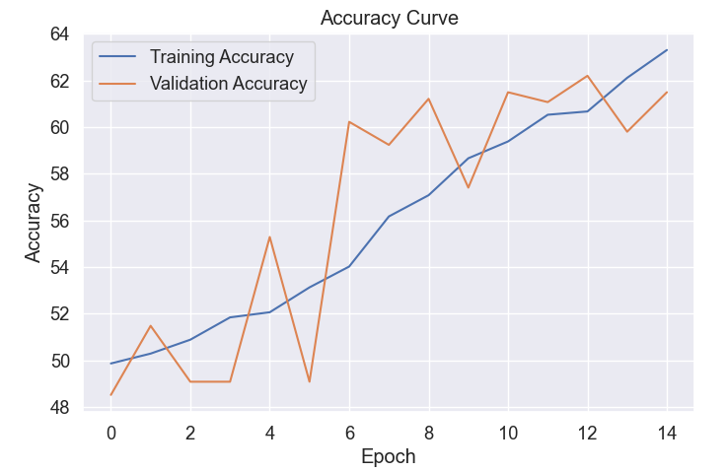
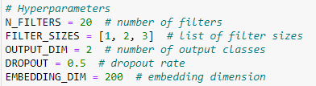
CNN Tuning
Example of our CNN tuning process over training epochs
Many different architecture configurations tried

Slide 12
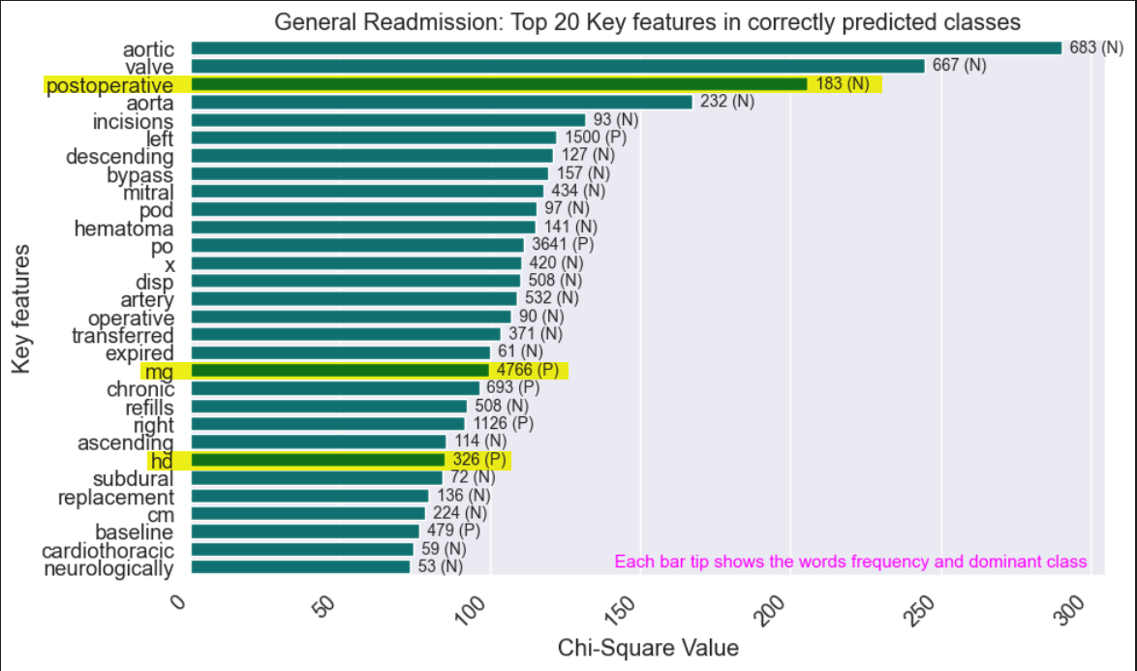
Chi-Square Feature Analysis
Correct predictions from the CNN have a chi-square score determined for each word in those hospital reports for both correct negative and positive predictions
They are then ranked by score as a proxy for relevancy
Domain expert required to meaningfully analyze positive versus negative
Highlighted words are words that the original paper also reported in their analysis

Slide 13
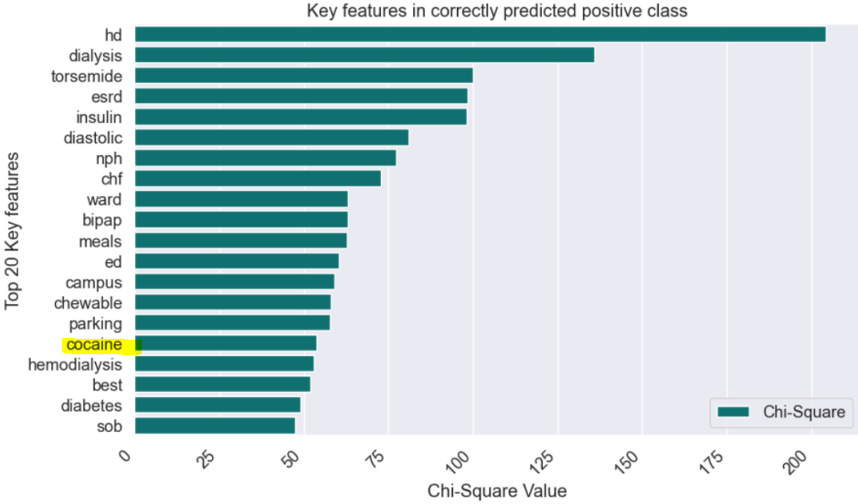
Chi-Square Feature Analysis
Some commonsense findings:
Cocaine associated with readmission

Slide 14
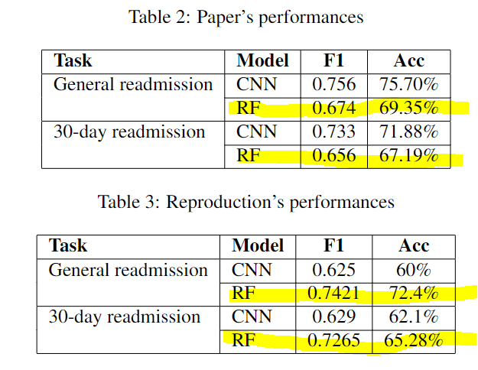
Results
RF outperformed our CNN and the paper’s CNN
This contradicts the paper’s hypothesis and challenged the reproducibility

Slide 15
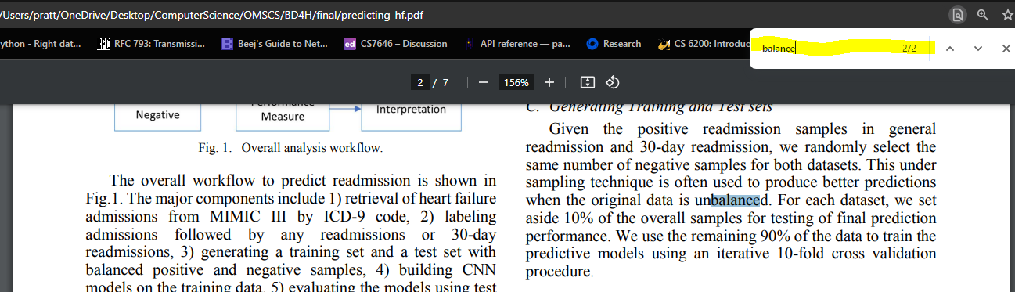
Understated implication of balanced data
Not discussed in abstract, introduction, or conclusions
Misleading as to model performance in real world

Slide 16
Discussion
Mixed reproducibility
Reproducibility of paper would be better with table of hyperparameter
Would greatly improve reproducibility if they provided code
Could facilitate research that uses their work such as comparison to latest models such as BERT (transformer models)
Could facilitate data scientists who wish to apply their findings in industry
Improves trust and transparency in the research community
Conclusion:
What seems obvious to the author may have ambiguity
Always provide code if possible
Explicitly state all hyperparameters in a table
Explicitly detail model training process

Slide 17
Sources
Original paper:
Xiong Liu, Yu Chen, Jay Bae, Hu Li, Joseph Johnston, and Todd Sanger. Predicting heart failure readmission from clinical notes using deep learning. In 2019 IEEE International Conference on Bioinformatics and Biomedicine (BIBM), pages 2642–2648.
Our Github repository:
https://github.gatech.edu/lpratt30/PredictingHF/tree/dev
Image sources, excluding ones we reproduced or from the original paper:
https://medium.com/mlearning-ai/word-embeddings-wordpiece-and-language-agnostic-bert-labse-98c7626878c7
https://www.mdpi.com/1424-8220/21/24/8163

